Slide 1





PRESENTATION 2026
[Starbucks Data Analytics]
Mentor Name
Student Name
Student Email
Umamaheswari
Priyanshi Mishra
priyanshi.mishra07082006@gmail.com

Slide 2

Outline
Abstract of the Project
Problem Statement
Proposed Solution
System Architecture
Live Demo of the Project
Embedded Video of Project
Conclusion
Future Scope

Slide 3

Abstract
Overview: This project transforms raw Starbucks customer data into a high-level Business Intelligence dashboard.
Objective: To identify patterns in customer behavior and use Microsoft Copilot for creation of data-driven marketing strategies.
Tools: Microsoft Excel, Microsoft Copilot (AI Analysis),and Power BI for visualization.
Outcome: A strategic dashboard that replaces manual data interpretation with AI-generated business insights.

Slide 4

Problem Statement
Starbucks collects millions of transaction points, but without proper visualization, it’s difficult for managers to get the insights of the business.
Data Inconsistency: Raw transaction logs are often messy,that lead to inaccurate business conclusions.​
Operational Inconvenience: Manually sorting through 3000+ rows of data to find specific trends is slow, exhausting, and prone to human error.
Eliminates the guesswork in marketing strategy
Gap: There is a gap between having "Big Data" and having "Useful Insights" that a manager can actually act upon quickly.

Slide 5

Proposed Solution
Automated Dashboard: I am building a structured Excel/Power BI dashboard that categorizes customers into distinct "Personas."
​Innovation: Shifting from "Reactive Reporting" (what happened) to "Proactive Strategy" (what to do next).
It highlights untapped market opportunities by cross-referencing age groups with location-based performance, ensuring that every promotional effort is directed toward the highest-potential audience segments.

Slide 6
System Architecture
Data Input / Source
Processing / Analysis
Integration of Portfolio (offers), Profile (demographics), and Transcript (events) datasets.
Data cleaning in Excel to remove unnecessary columns, changed data type, added age segmentation, handled income.
AI / Tool Integration
Output / Dashboard
AI Integration: Microsoft Copilot used to derive behavioral patterns and generate insights, summaries, or content outputs and Power BI to build a interactive dashboards.
An interactive dashboard or structured analytical report that clearly communicates key insights from the data.

Slide 7
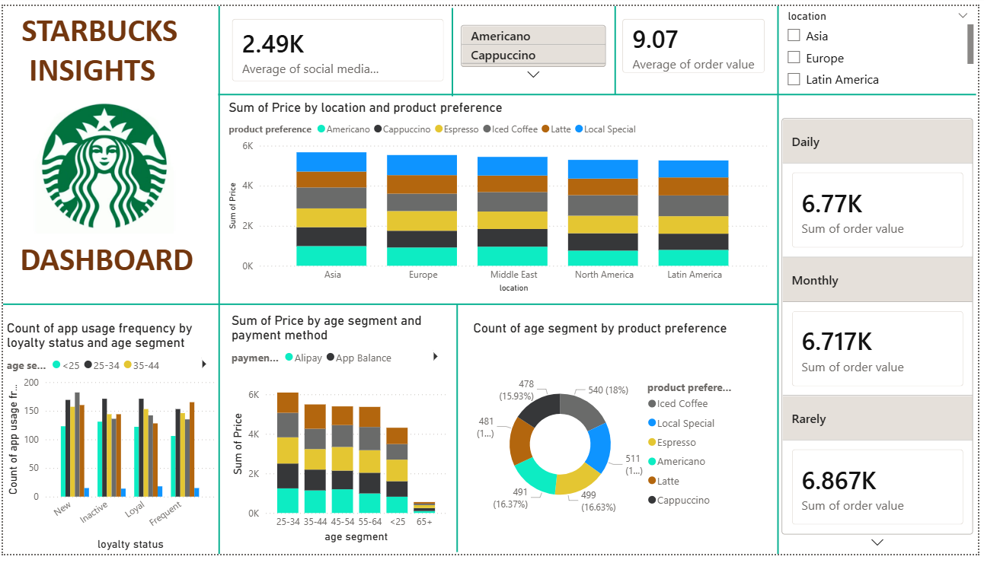
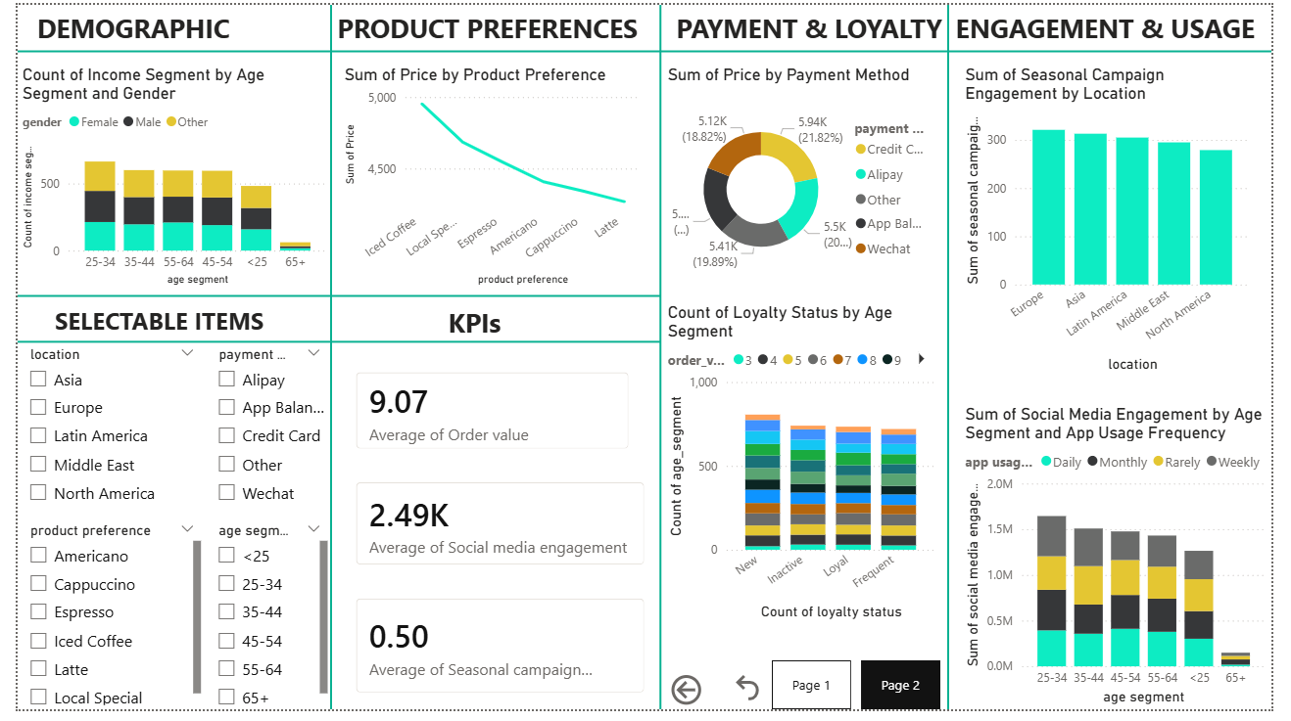
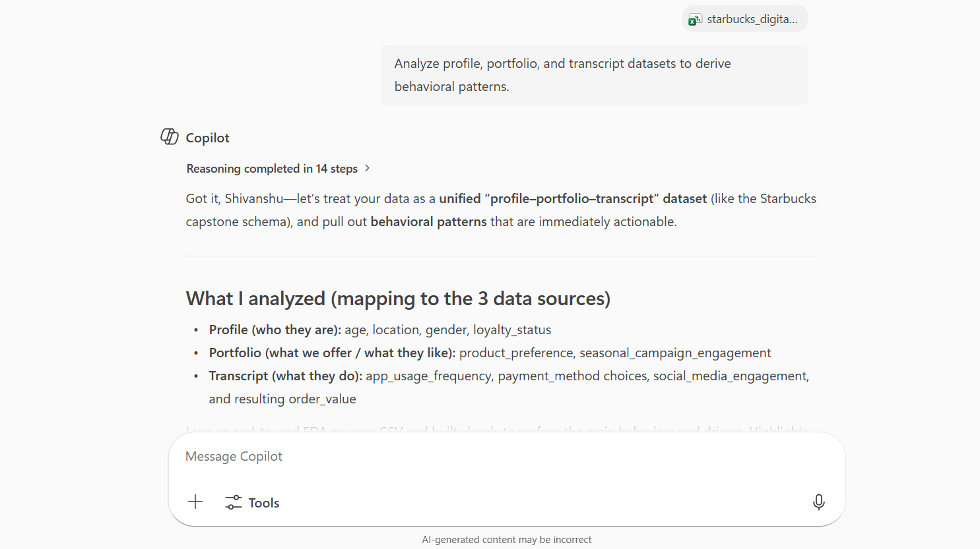
Live Demo of Project
Here's the list of some demo screenshots / features of the project:
Demo 1
Demo 2
Demo 3

Slide 8
Video of Project Demo
https://1drv.ms/v/c/c54ba3bd296ecefd/IQAZiKX--4IhQaU71Q5OgC82ATBplKqLNmg3QUPG6DcmjJM?e=bfg5td
▶
[Insert your project demo video.
You can embed a video your live project.]

Slide 9

Conclusion
Successfully simplified a massive dataset into a clear, visual tool for decision-makers.​
Removed the inconvenience of manual data entry and ensured data integrity by resolving inconsistencies.
The project adds value that how AI and Data Analytics can turn "hidden" information into a clear roadmap for business growth and customer satisfaction. Provided a scalable framework for personalized marketing that solves the "Inconvenience" of manual data analysis.
CONCLUSION

Slide 10

Future Scope
Real-time Tracking: Connecting the dashboard to live store data for up-to-the-minute decision making.​
Predictive Budgeting: Using AI to predict which marketing campaigns will have the highest return before spending the budget.
​Multichannel Expansion: Applying this dashboard model to analyze customer loyalty across other retail and financial service platforms.

Slide 11
Thank You
AICW Fellowship | Student Project Presentation 2026
LinkedIn | Edunet Foundation

